Slide 1


SHREY PES2UG21CS500
SUJAL S
PES2UG21CS548
SUDHANVA SAMAGA PES2UG21CS544
SOCKET PROGRAMMING

Slide 2
INSTANT MESSAGING
Socket Programming

Slide 3
PROJECT ABSTRACT
THE OBJECTIVE OF THE SOCKET PROGRAMMING PROJECT IS TO BUILD AN INSTANT MESSAGING PLATFORM
THE CLIENT ESTABLISHES A CONNECTION WITH THE SERVER (TCP PROTOCOL).
BASICALLY OUR PROJECT IS SIMILAR TO ANY MESSAGING PLATFORMS BUT CAN ONLY ESTABLISH COMMUNICATION WITH ONE HOST.. ☺

Slide 4
TOOLS USED
PROGRAMMING
PYTHON
CONNECTION
SOCKET PROGRAMMING
PROTOCOL
TCP
USER INTERFACE
TKINTER

Slide 5
DESIGN AND IMPLEMENTATION
A SECURE SERVER AND CLIENT COMMUNICATION.
SERVER CAN COMMUNICATE WITH CLIENT IF AND ONLY IF CONNECTION IS ESTABLISHED.
COMMUNICATION CAN HAPPEN TO INFINITY TIME BEFORE CLOSING CONNECTION.
IT IS POSSIBLE TO CHAT WITH ONE HOST ONLY.

Slide 6
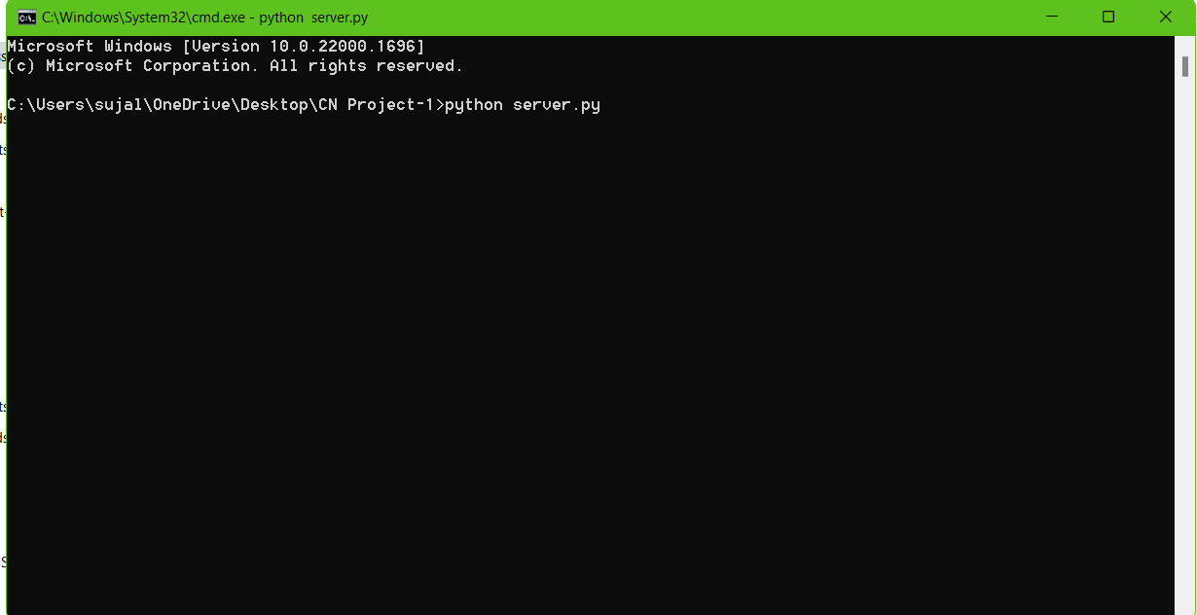
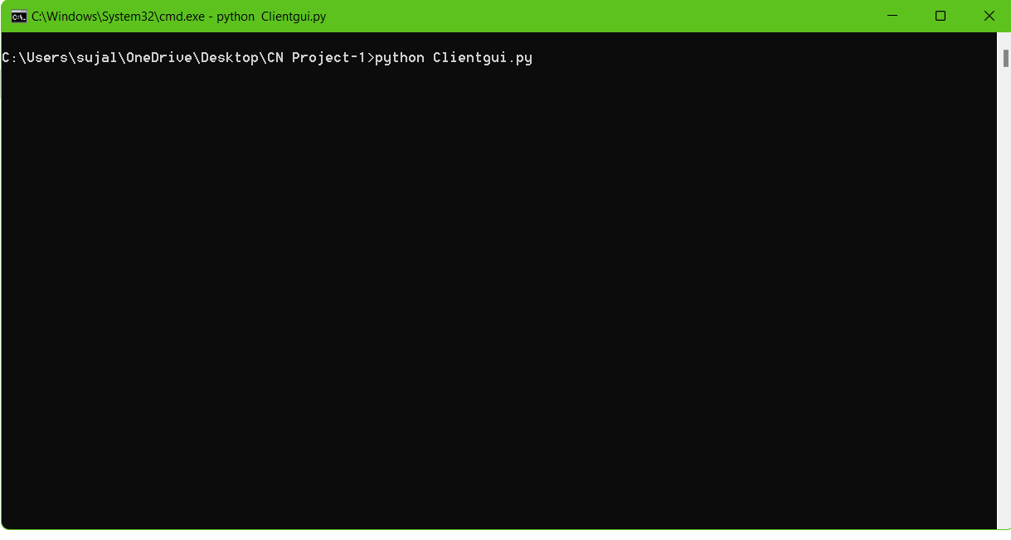
SERVER IS RUNNED BY THE ABOVE SYNTAX
CLIENT IS RUNNED BY THE ABOVE SYNTAX

Slide 7
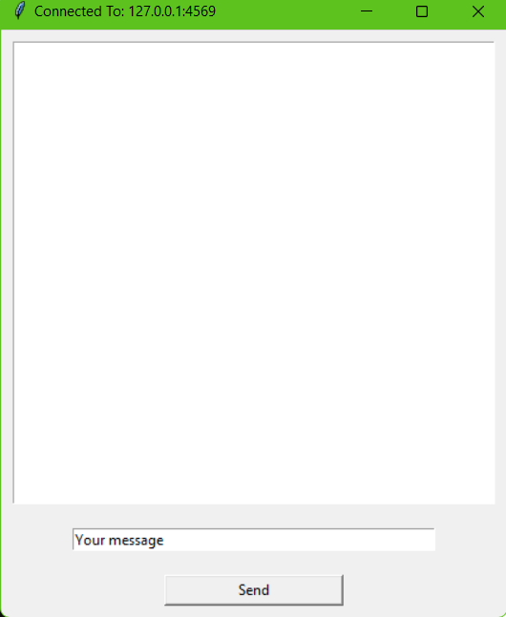
THE GUI CLIENT SIDE

Slide 8
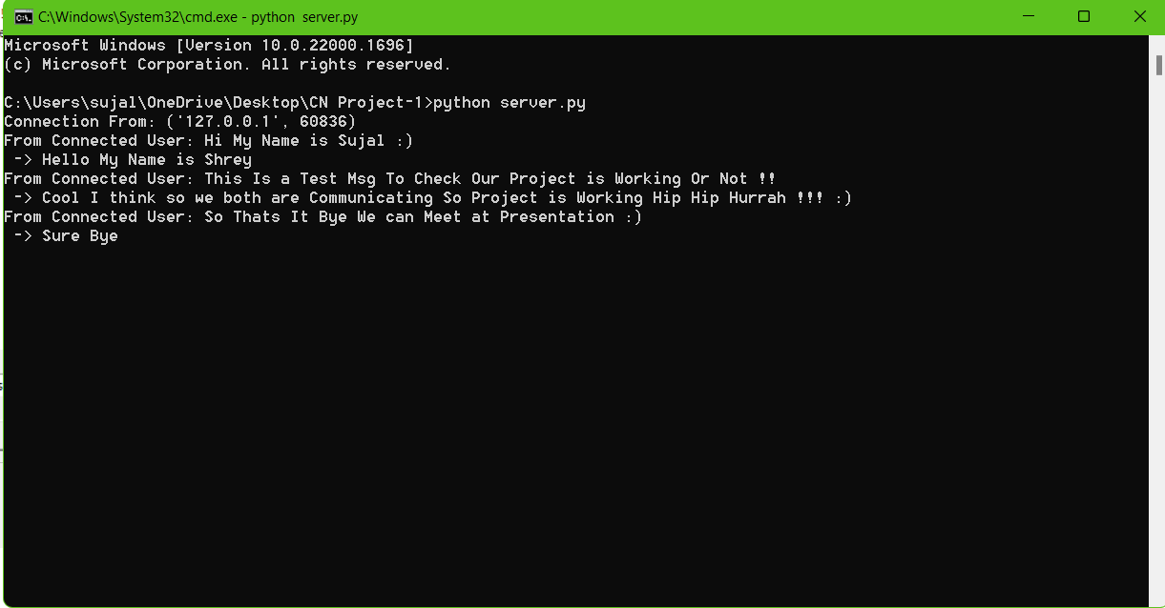
SAMPLE OUTPUT
WITH RESPECT TO SERVER SIDE

Slide 9
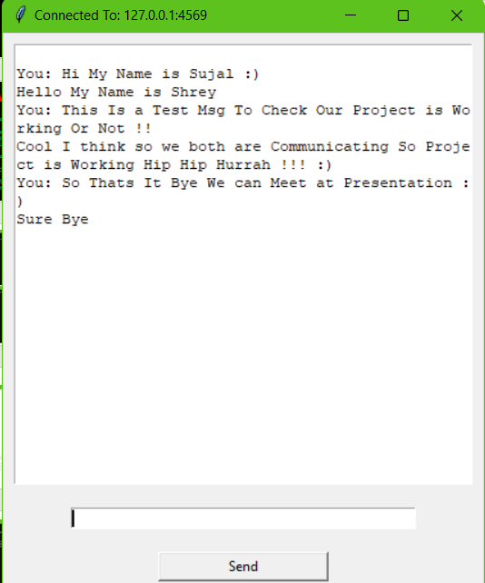
SAMPLE OUTPUT
WITH RESPECT TO CLIENT SIDE

Slide 10
OUTPUT WHEN HOST IS FORCEFULLY STOPPING THE CONNECTION

Slide 11
CONCLUSION
From the ‘INSTANT MESSAGING’ project we learned how to implement TCP socket programming using Python.
We also learnt about Establishment of PORT NUMBERS
This Project helped us to reuse Python – TKINTER Library

Slide 12


